Slide 1
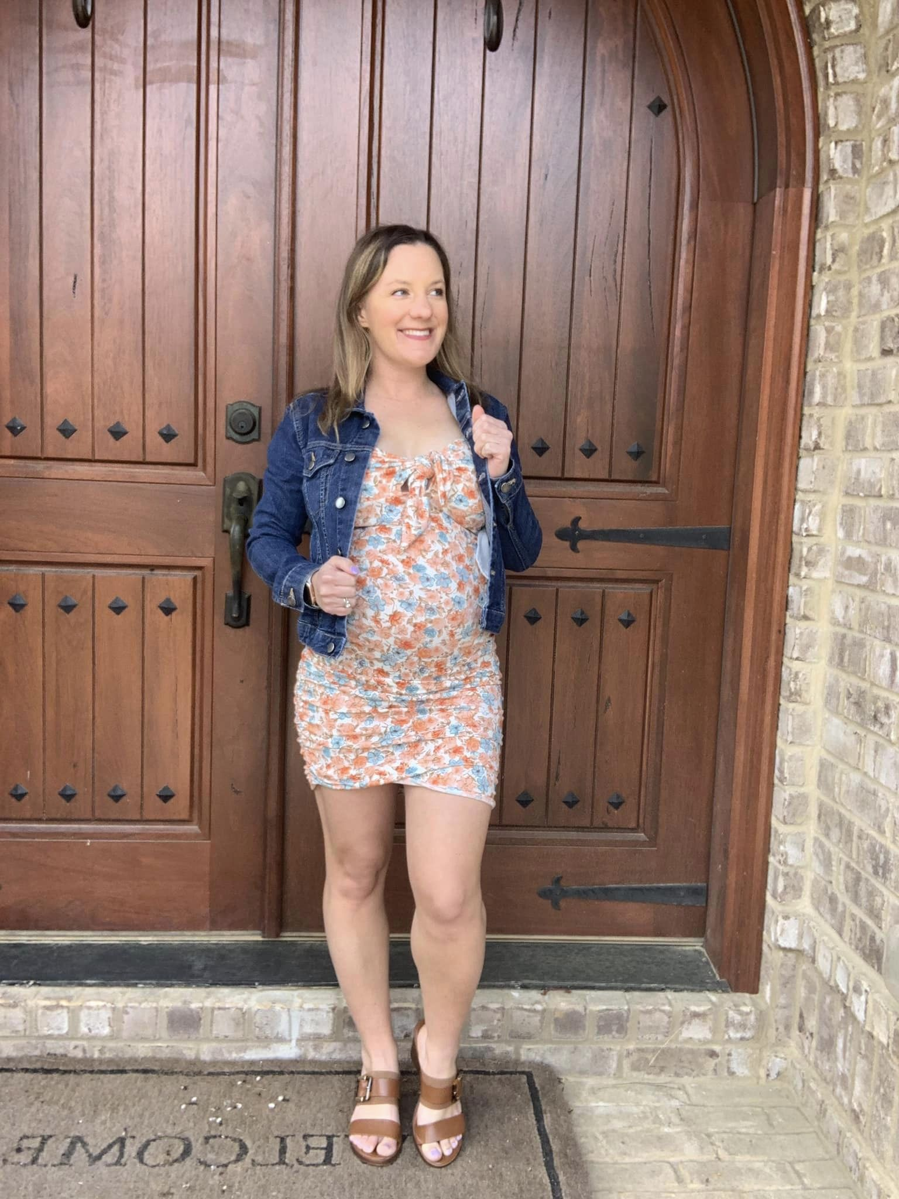
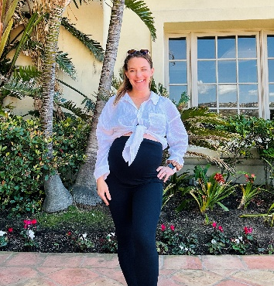
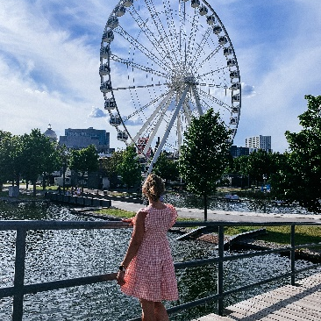
Lauren Slimming
@travelingteachermama
Hi, I’m Lauren
I’m a millennial mom, teacher, and travel lover who is passionate about helping moms and sharing how they can make the most out of life and motherhood through parenting hacks, self-care advice, and family travel tips.
I love sharing things with my audience that will help them simplify their routines, live a happier day-to-day, and inspire them to taking the plunge into living their best lives.
Location
73%- United States
4%- United Kingdom
4%- Canada
1.5%- Nigeria
1.5%- India
SOCIAL STATS
@travelingteachermama
2, 454+ FOLLOWERS
Engagement rate: 4 %
Avg. story views: 200
www.travelingteachermama.com
AVG MONTHLY VIEWS: 400
Age
@travelingteachermama | hello@travelingteachermama.com| MEDIA KIT 2023

Slide 2
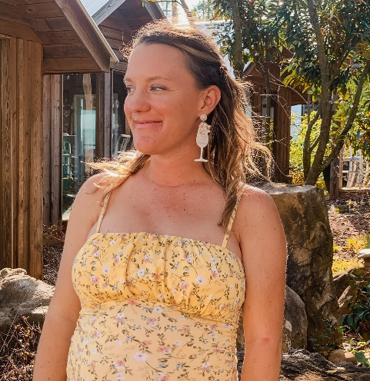
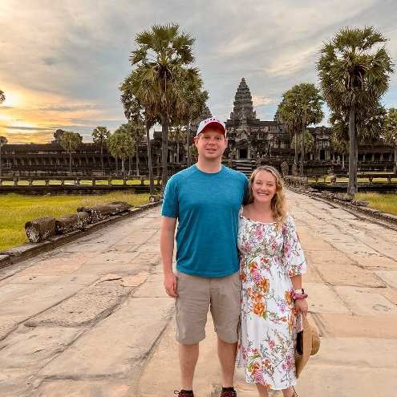
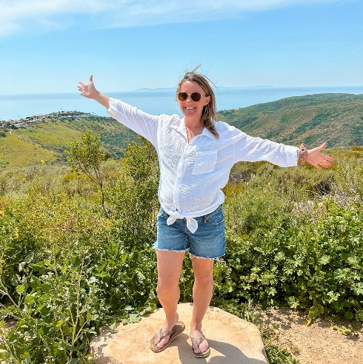
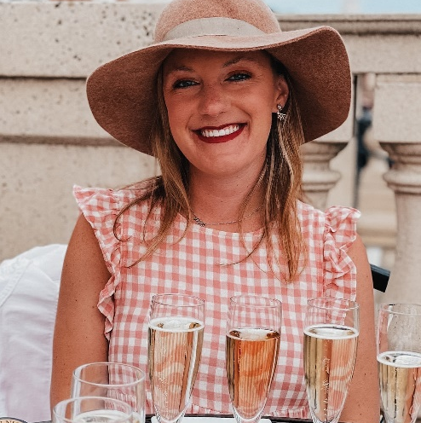
LET’S WORK TOGETHER
PREVIOUS PARTNERSHIPS
Ig photo: $150 USD
Brand Exclusive Instagram Photo
BabyBub
CoBoo Mom
Sisu Mum
Ceres Chill
One Pumped Mama
Mammaway
IG STORIES: $100 USD
4x frames, 2x links
IG post + stories: $175 USD
Brand Exclusive Instagram Photo
4 frame IG Story
IG CAROUSEL: $200 USD
Dedicated Instagram Carousel
(2-3x images)
IG REEL: $200 USD
Includes in-feed posting
IG VIDEO: $100 USD
Brand Exclusive Instagram Video, 30 seconds
If you’re interested in any other collaborations or package deals, please get in touch via email at hello@travelingteachermama.com
@travelingteachermama | hello@travelingteachermama.com| MEDIA KIT 2023

